Slide 1



VR

Slide 2
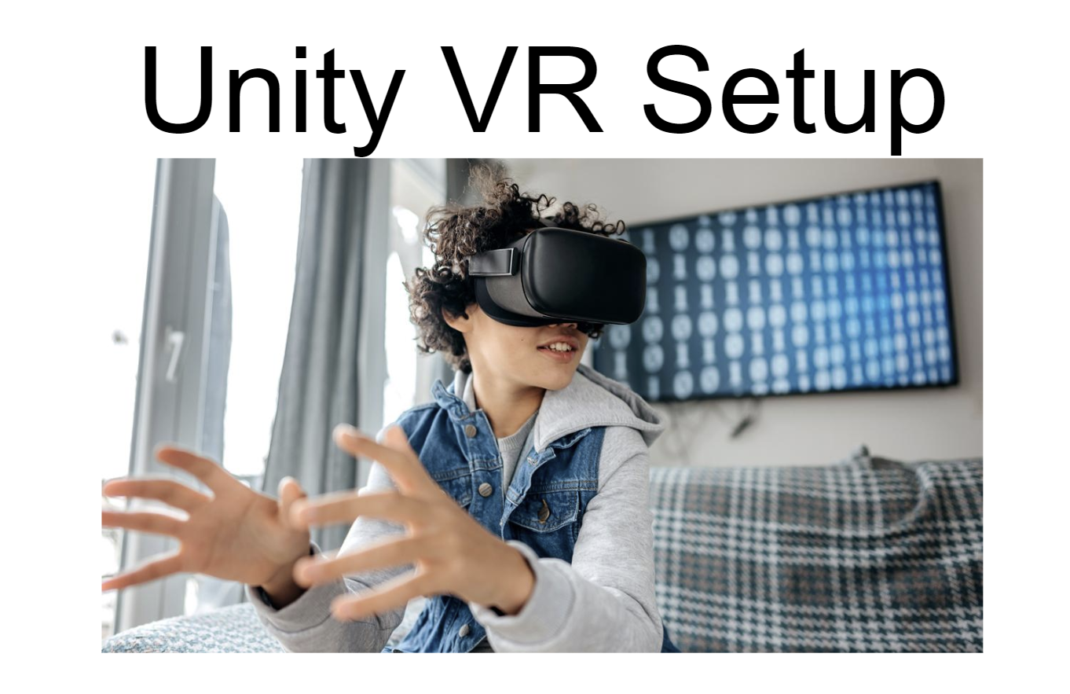

Recap - Unity VR Setup && Unity Collaboration
Unity Collaboration
Remember the earlier you get setup in VR … the less stress later

Slide 3

Timeline
Week 4 - Unity Collaboration
Week 5 - Virtual Reality Setup
Week 6 - Colliders, Triggers, Scene Changes, Animation
Week 7 - Lighting & Sounds
Spring Break
Week 8 - Optimization
Week 9 - Midterm Presentations

Slide 4

Review Time - Colliders & Triggers

Slide 5
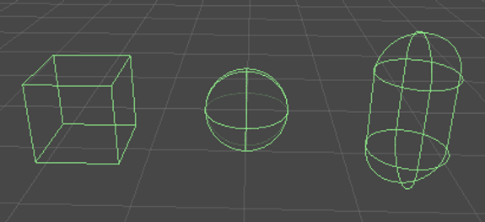
Colliders
To handle collision between GameObjects, Unity uses colliders. A collider is a Unity component that defines the shape of a GameObject for the purposes of physical collisions. Colliders are invisible, and do not need to be the same shape as the GameObject’s mesh.

Slide 6
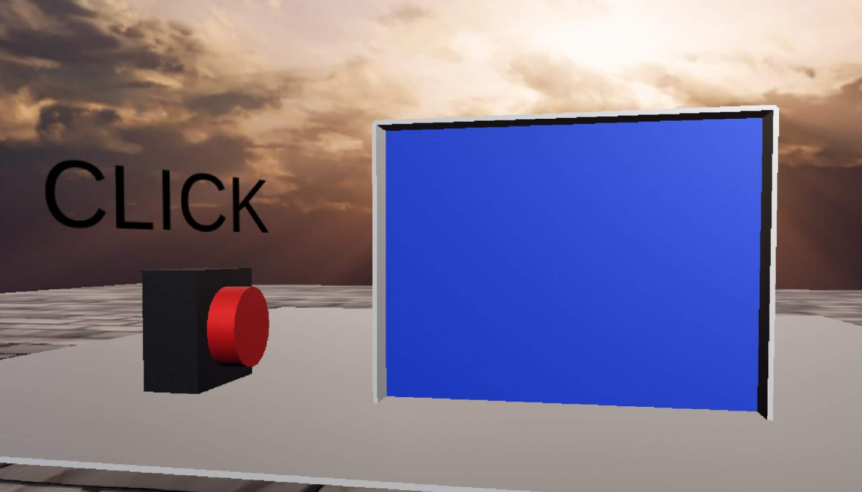

Trigger Colliders
Trigger colliders don’t cause collisions. Instead, they detect other Colliders that pass through them, and call functions that you can use to initiate events (see Use collisions to trigger other events).

Slide 7
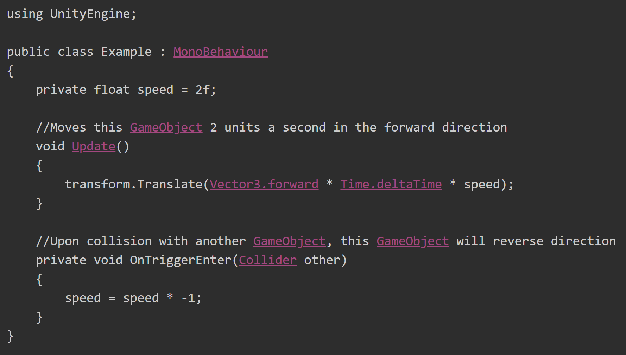
More Triggers
Note: Both GameObjects must contain a Collider component. One must have Collider.isTrigger enabled, and contain a Rigidbody. If both GameObjects have Collider.isTrigger enabled, no collision happens. The same applies when both GameObjects do not have a Rigidbody component.

Slide 8

Tutorial
Adding Hands to your VR Player
Collision Detection
When our hand collides with an object what can happen?
Pickup, Scene Changes, Secret Doorway, Animation (endless possibilities)
Animation crash course
Prefabs

